Slide 1
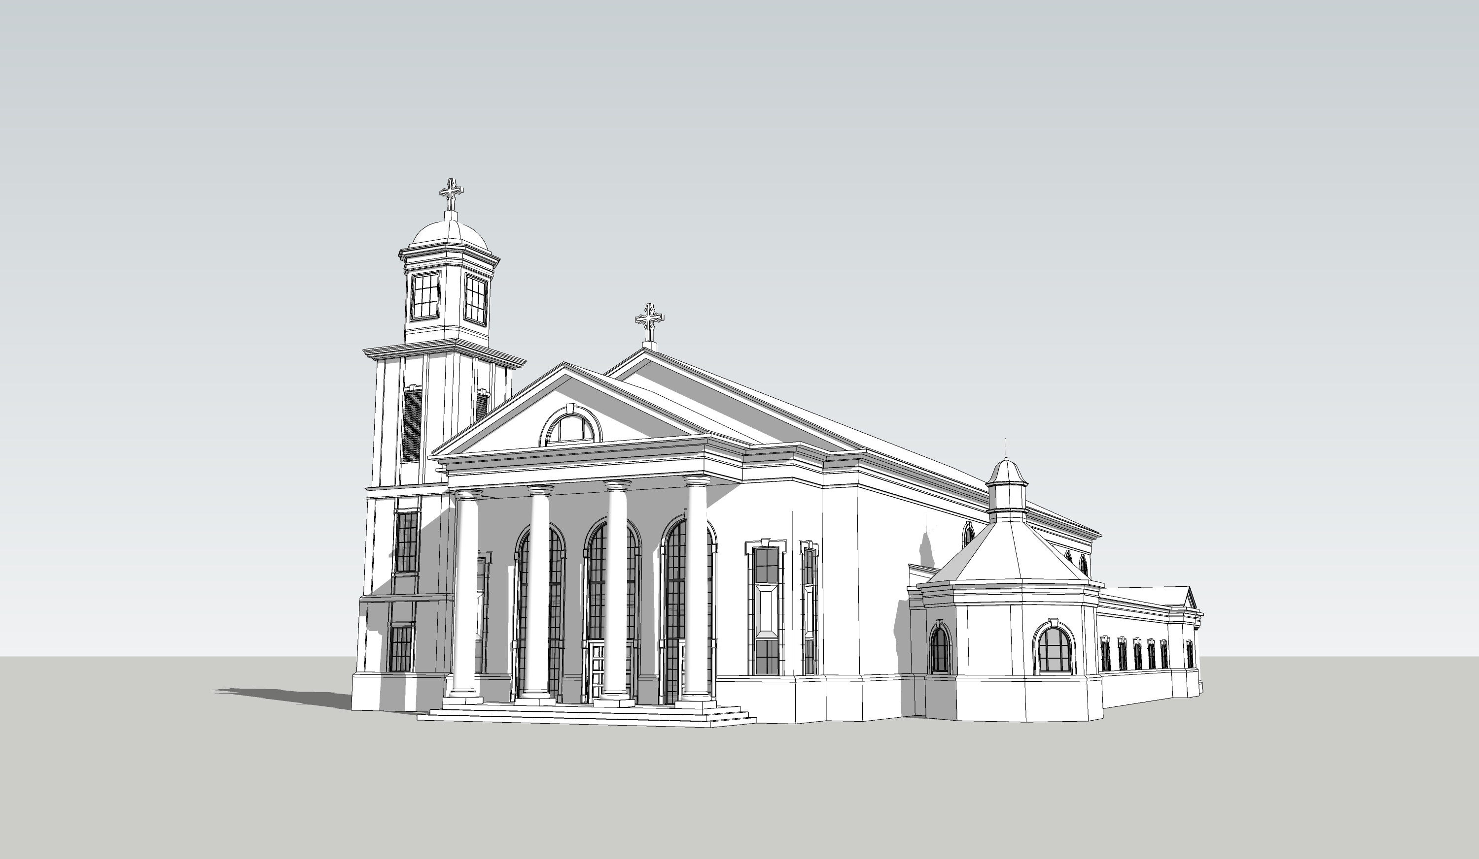
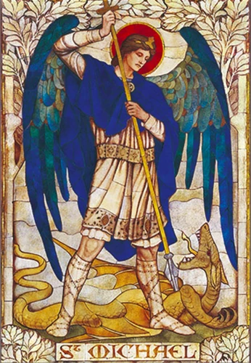
St. Michael’s Church Construction Project

Slide 2
The 1st step was to determine the direction of the project
      Should we build on the current site?
      Should we buy land?
      Should we purchase an existing facility?
After searching throughout the Atlanta metro area and looking at all possibilities, we came to the conclusion that the best option was to build right here in Roswell on the existing 7-acre parcel.

Slide 3
THE 2ND STEP WAS THE selection of the right group of professionals to represent St. Michael’s in this construction project
RTF CONSTRUCTION
RARDIN AND CARROLL
25 years of experience
voted # 1 general contractor in Roswell, Georgia
experience in building many churches
specialize in designing churches
have extensive knowledge about architectural history
They want to help us design a church to emulate and complement the neo-classical altar that we have inherited.
42 years of design experience

Slide 4
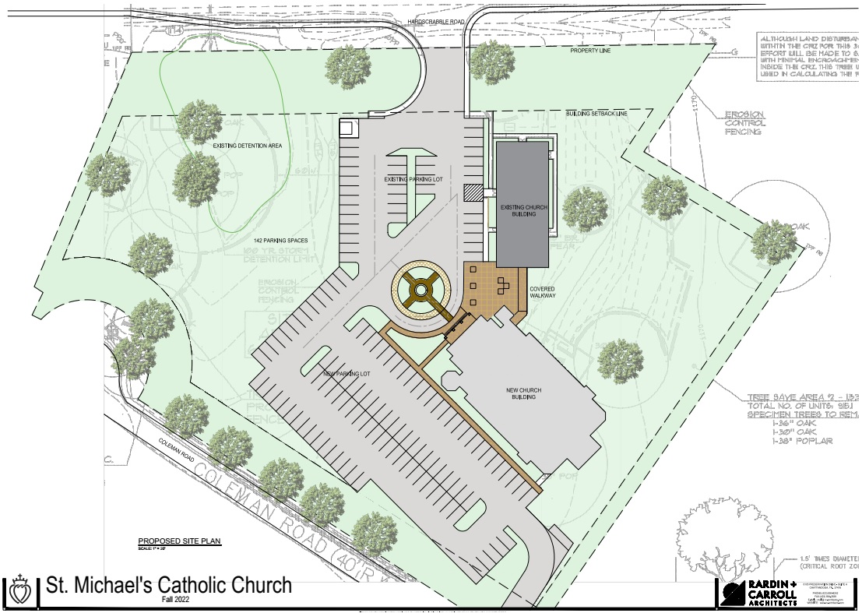
THE 3rd step was determining the best location for the church on the property
positioning the church in the best spot to keep the parking lot separate from where parishioners socialize
adding a large patio area
adding a covered walkway to the parish hall
hopefully adding a 2nd driveway
adding a roundabout in front of the church for drop off and pick up of the elderly, the handicapped, and young children

Slide 5
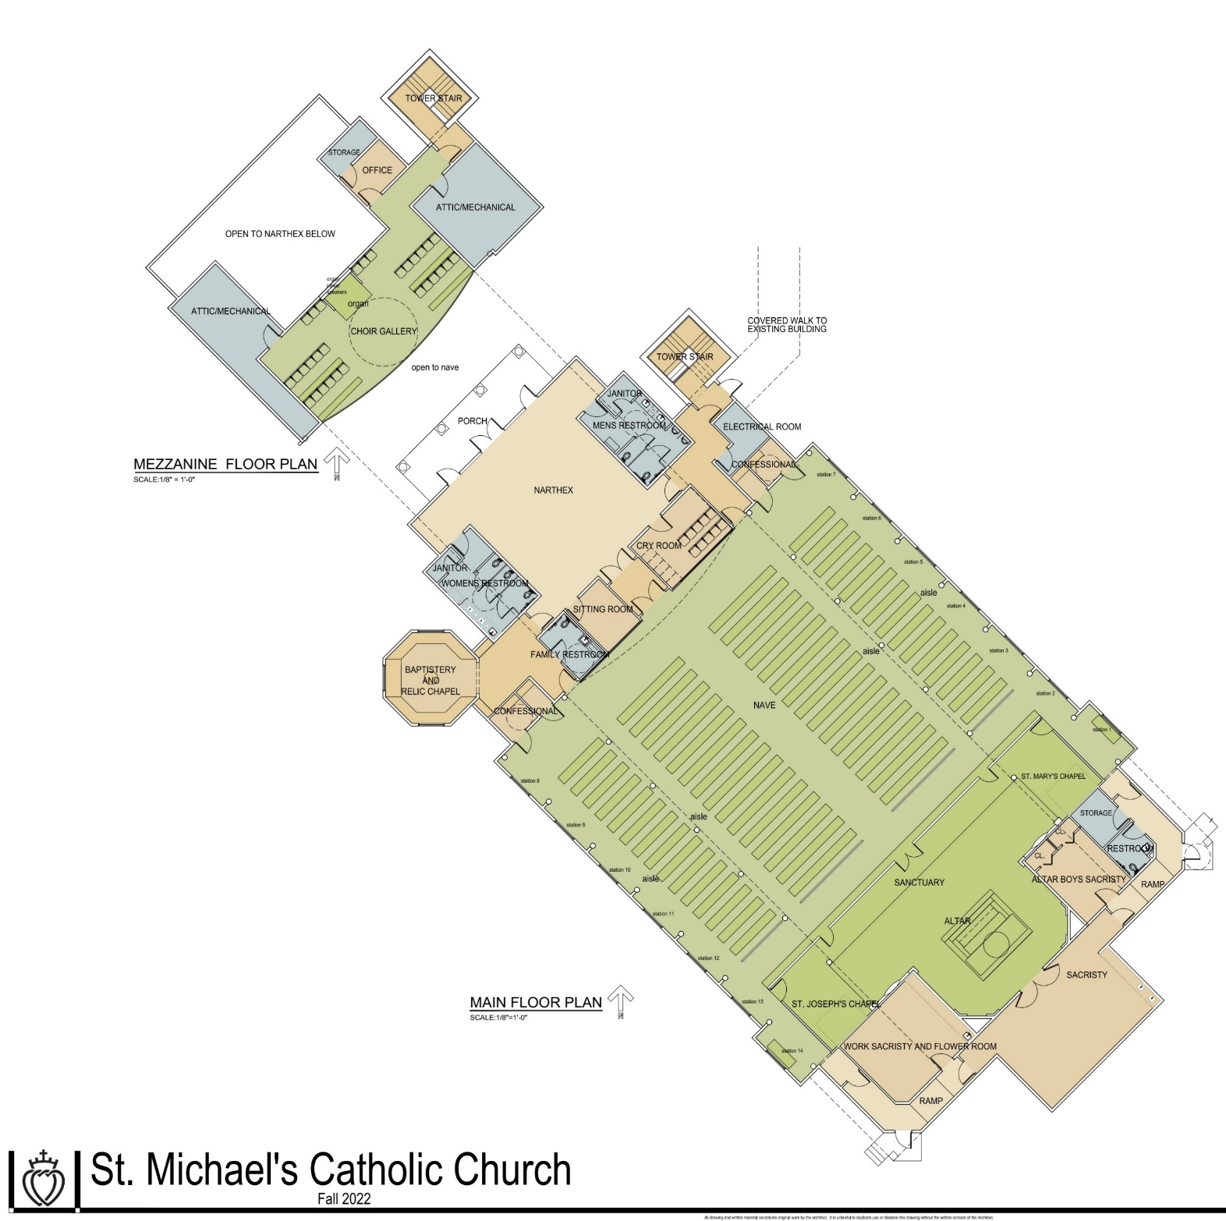
THE 4th step Floorplan design
Fr. Danel helped design a floorplan that will be very functional, efficient, and accommodating for both clergy and laity.
large narthex
octagonal baptistery and relic chapel
For privacy, the confessionals were specifically positioned to not share interior walls with other rooms.
family bathroom
baby changing tables in all bathrooms
a large accommodating cry room
a sitting/meeting room off the vestibule for the priest to meet privately with parishioners
a large choir loft
an office for accounting for ushers
three large sacristies for priests, altar boys, and flower arranging
plenty of storage throughout

Slide 6
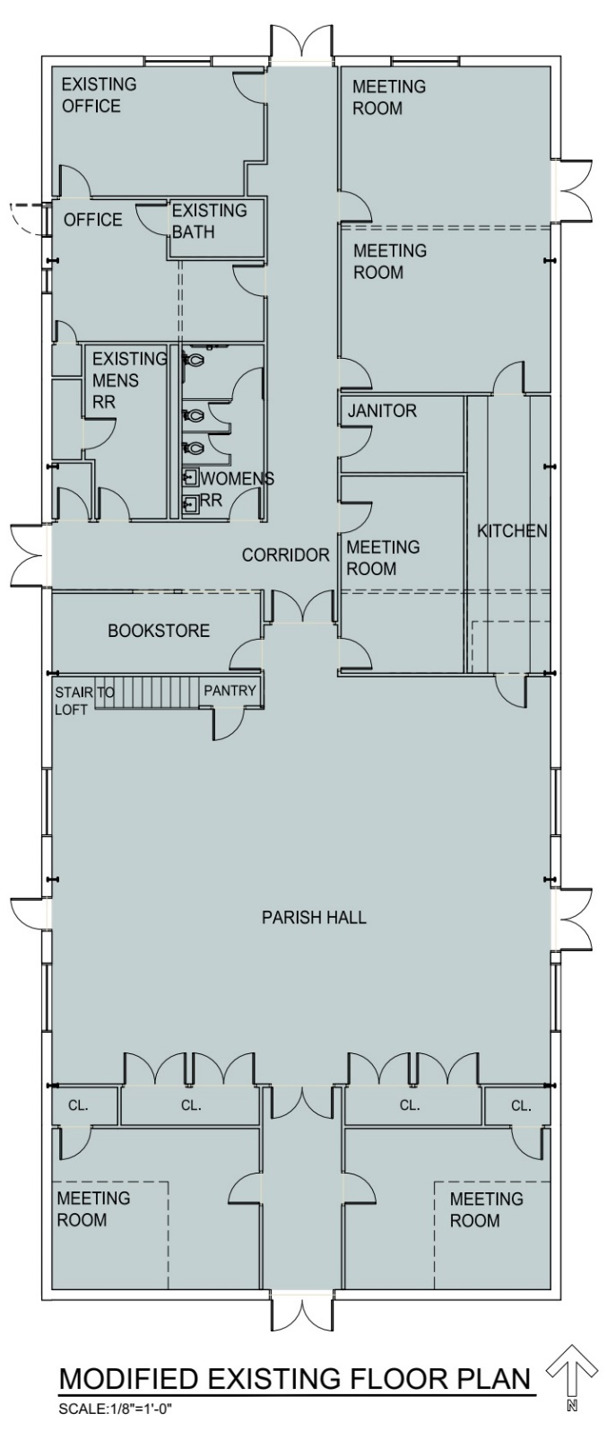
THE 5th step Existing Building Renovations
adding meeting rooms (6 total) for multiple uses such as communion classes, confirmation classes, and catechism classes but especially for the growth of the Stella Maris Academy that Mrs. Jacquelyn Couchell and Mrs. Judith Grieco have been diligently working to grow and develop into a school program to enrich our children with a traditional Catholic education
adding closets for extra storage
lengthen the kitchen to serve the new parish hall as well as the original parish hall space
relocate the bookstore to where the baptistery and relic chapel are located now
relocating the women’s bathroom
adding a new entrance from the patio and an extra double door to the playground

Slide 7
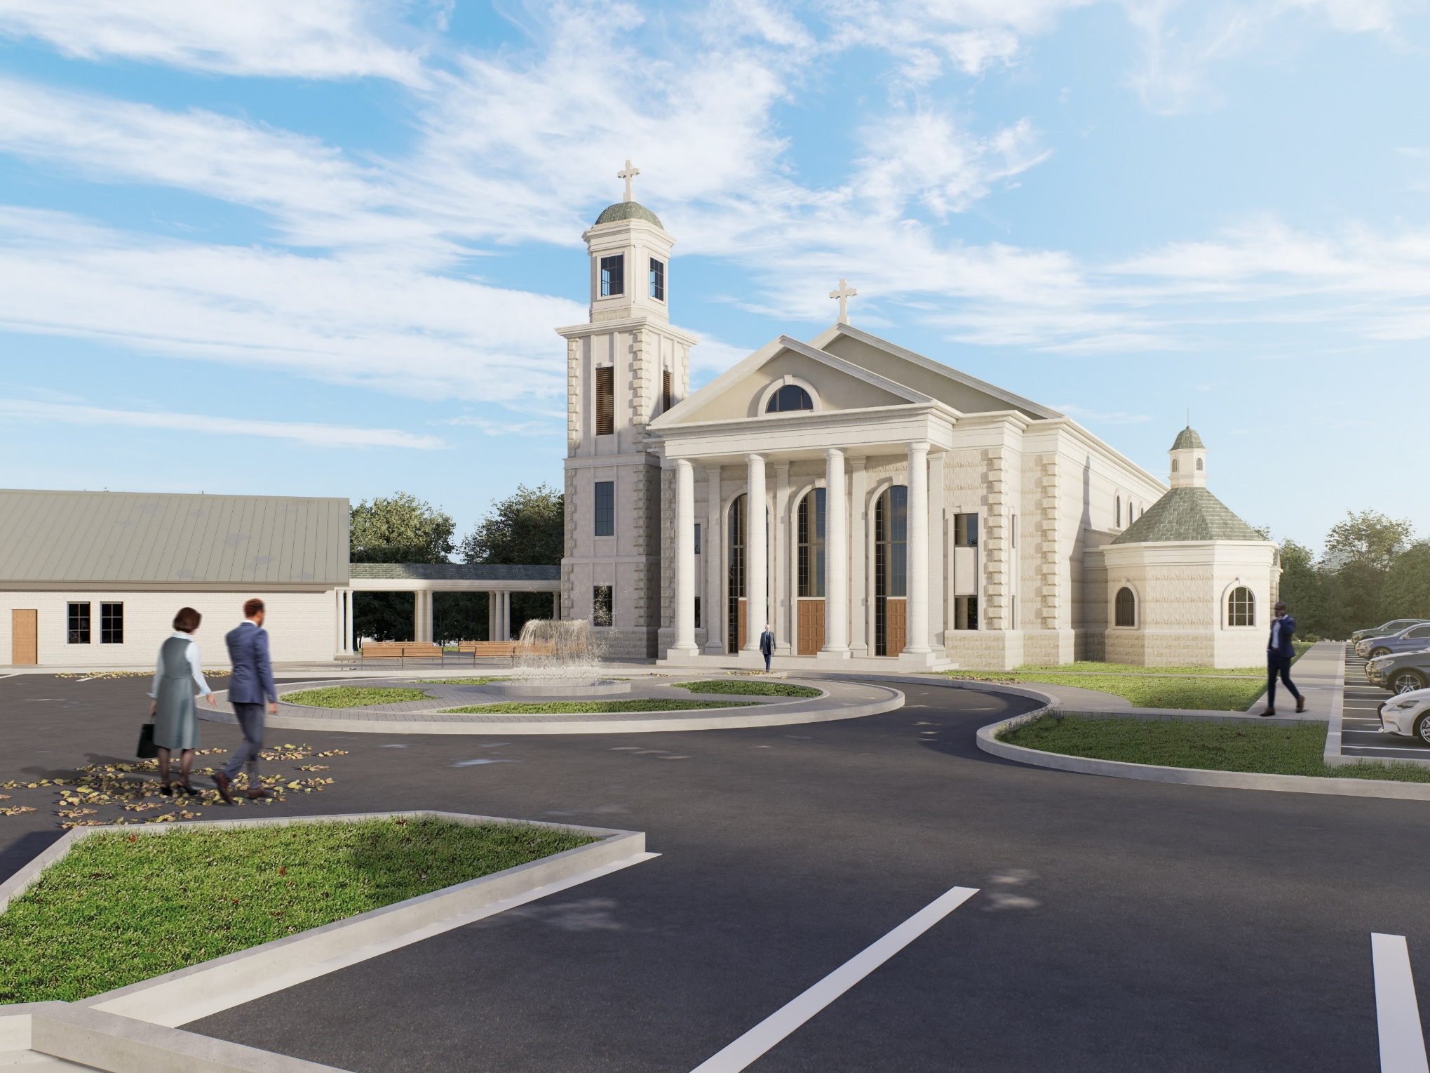

Slide 8
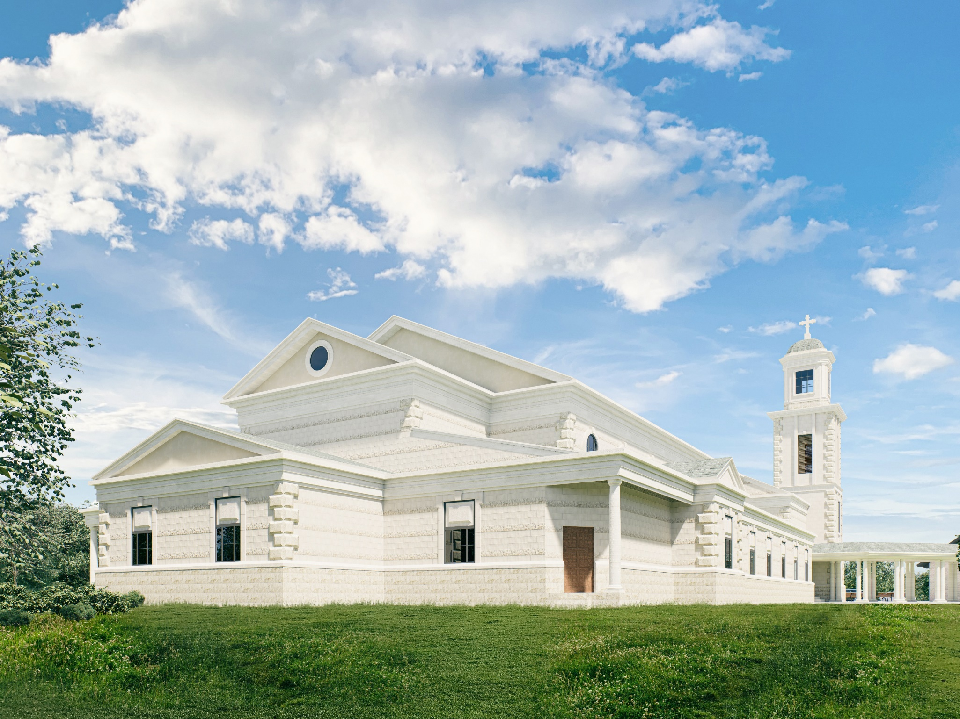

Slide 9
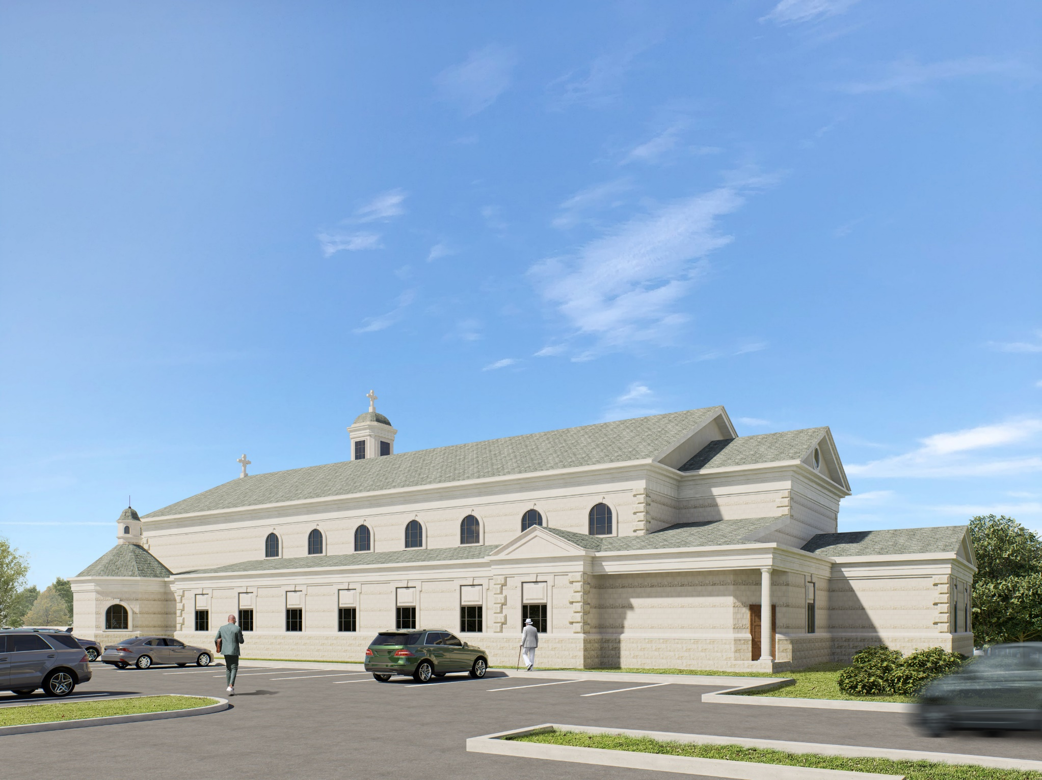

Slide 10
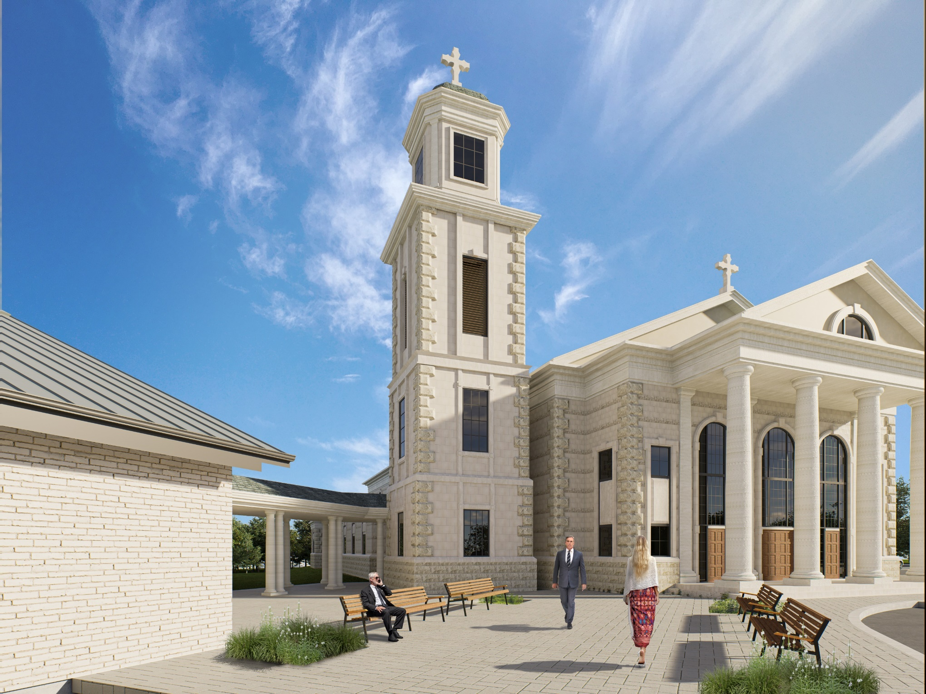

Slide 11
Cost: based upon customary building costs for this type of construction, the cost is estimated at about $5 million.
As plans are finalized more exact numbers WILL BE known and will be communicated to everyone.
THE GOOD NEWS:
• WE’RE HALFWAY THERE!!!
• The sspx US DISTRICT WILL BE LOANING SAINT MICHAEL’S $500,000.
• We have saved $900,000 which can be used for this project.
• $1,000,000 has been donated to the project by one generous family.

Slide 12
• Past obligations are satisfied and behind us
• Land purchased for present site – 7 acres for $140,000
• Present building paid off $750,000 loan in 10 years way ahead of schedule
• Purchased and paid off Church rectory in 5 years
• We have had A lot of success and we have done things ahead of schedule.
• All this done with only around 180-200 parishioners -- There are over 400 parishioners currently attending mass every Sunday.

Slide 13
• We must know where we stand before we begin!
We can break ground WHEN we HAVE THE FUNDS RAISED OR PLEDGED TO pay for this project (SSPX won’t allow bank loans).
• Contributions for the building project must be evaluated separately from regular support to St. Michael’s. Don’t cut your regular support for the chapel to fulfill your pledge.
• The critical part is raising cash now and the pledges to complete the financing so we can break ground.

Slide 14
We want you and your families to give serious and prayerful thought to what you each can do.
Pledges will only be temporary (3-5 years).
  Can we make sacrifices like we would if we were paying for a family car or addition to the home?
  Can we do without some things that aren’t essential?
    Cable TV
    Amazon, STARBUCKS, ETC.
    Streaming subscriptions
    EXPENSIVE cell phone PLAN
    Postpone big personal projects
    These are just some ideas – you can think of more!
• These are personal decisions for each family to make.

Slide 15
Methods of giving to St. Michaels
Make an outright gift of stated amount.
Join a guild and pledge money. (Review the pledge card.)
  The great need is for cash up front so that the building project can commence!
  Consider a large down payment up front with satisfying the remaining balance over the term of the pledge period.
  Guilds should accommodate every level of giving. It is important to give monthly through the bank draft. This method gives us more ability to secure a loan from the district since the flow of funds is under our control.
If funds are deployed in market-based investments consider the following:
  Portfolios usually have a cash balance.
  If waiting for returns in portfolio:
    Use margin or collateralized loan if available. (This involves risk that you could lose securities in a margin call.)
    Use HELOC. (Home Equity Line of Credit current rates around 4.5%) You must have equity in home sufficient to do this (less than 80% loan to value).
    personal loan or business loan if you still have PPP money
If funds are invested in an IRA and you are at least age 70 ½ consider doing a QCD (Qualified Charitable Distribution).
  money goes directly from IRA to St. Michaels
  donor does not get taxed on the distribution (tax free although you will receive a 1099)
  maximum you can contribute this way is $100,000 per year per person by IRS regulations

Slide 16
5. bank drafts for direct deposit to St. Michael’s through sspxatlanta.com/donations
6. credit card donations also through sspxatlanta.com/donations (you can opt to cover fees)
7. gift of stock or bonds (in kind)
a. If the asset is highly appreciated you are avoiding the capital gains tax by donating to St. Michael’s.
b. If the asset is held at a loss you may want to cash it in to use the tax loss carry forward.
8. gift of real estate or other real assets:
a. land or other property
b. gold or silver coins or bullion
c. artwork
d. cars
Our website (sspxatlanta.com) has links to make electronic donations
We need cash now (Father wants everyone with an income to join ONE OF THE guildS LISTED ON THE PLEDGE CARD). The level you choose is up to you, but pray and ask yourself what you can give to God for all He has given you.
Every donation counts. Thank you for your generosity!

